Slide 1
Graph-based variant detection
Todd Treangen

Slide 2
Goals for a metagenomic assembler
Must work well for clonal data
handle repeats
handle errors
deal with low coverage regions
Must deal with polymorphisms
distinguish between errors and polymorphisms
– distinguish between repeats and polymorphisms
– enable discovery of polymorphisms/variation

Slide 3
Repeats in metagenome
High coverage regions -> abundant organisms
Repeats are genome sized due to closely related strains in the sample
Isolate genome
Metagenome
Species 1
Species 2
Species 3
Notes:
Although the statistical methods seem to work well in single genome assembly, they can not be applied to metagenome assembly. Metagenome consists of a mixture of organisms. So if some organism is more abundant in the sample, it will have higher coverage despite of not being a repeat. By removing such regions, a valuable information is lost. Also, repeats are very large in length in metagenome due to closely related strains in the sample. For example, in this figure, regions marked by green are repetitive regions. In case of isolate genome, repeats are small in length but in case of metagenome, repeats are much larger in length. We do not want to remove such regions as it would result in loss of valuable information while reconstruction of genomes.

Slide 4
Why assemblers break contigs?
Genome
Reads
Contigs
Not enough coverage to assemble!

Slide 5
Why assemblers break contigs?
Genome
Contig 2
?
Contig 1
?
Contig 3

Slide 6
Genome scaffolding
Assembled Contigs
Orthogonal Linkage Information
Scaffolds

Slide 7
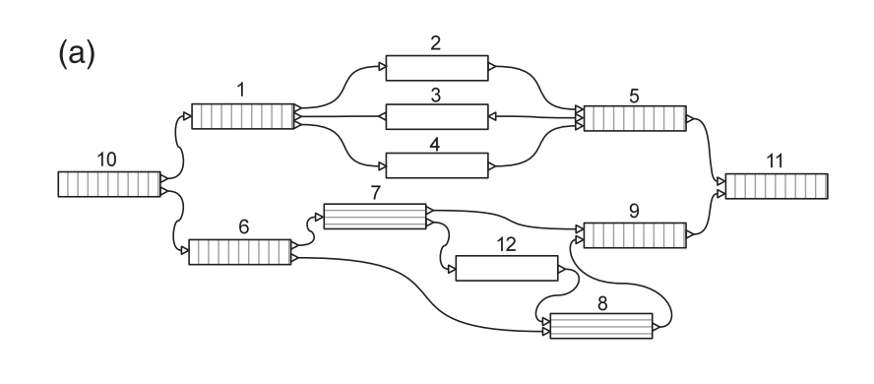
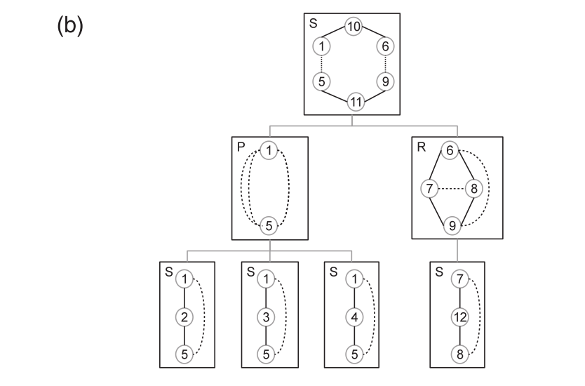
Variant Detection Using Graph Topology
SPQR Tree
If two nodes lie in the same node of SPQR tree and share a virtual edge, then they are start and end of a bubble!
Figure credits: Nijkamp et al., 2013

Slide 8
Prior work
Very few scaffolding methods available for metagenome data
Assemblers like MetaSPAdes (Nurk et al., 2017) have inbuilt scaffolding modules
Bambus2 (Koren et al., 2011) is the only standalone metagenome scaffolder
Not easy to use, requires specific file formats
Both don’t scale to large data

Slide 9
MetaCarvel Pipeline
Paired end reads
Link Construction and Bundling
Repeat Detection
Contig Orientation
Variant Detection
(Kececioglu and Myers, 1995)
(Huson et al., 2001)
Approximate Betweenness Centrality and coverage skew
Short read assembly
Ghurye, Jay, and Mihai Pop. "Better Identification of Repeats in Metagenomic Scaffolding." WABI, Aarhus-Denmark, 2016.

Slide 10
Variant detection using graph topology
Species 1
…AACTTACGTGAAAATACAACTTAGGACTA…
Variations in the sequences cause bubble in the graph
Naïve search for all bubble is exponential in the number of nodes
Use a SPQR tree based approach to find out bubbles (Nijkamp et al. 2013)
Runs in O(V+E) time (Gutwenger et al. 2001)
Species 2
…AACTTACTTGAAAATACAACTTTGGACTA..
ACGTG
TTAGG
AACTT
AAAAT
ACAAC
GACTA
ACTTG
TTTGG

Slide 11
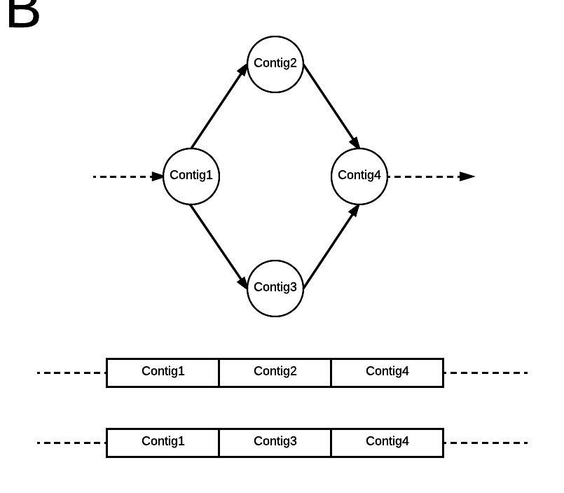

Slide 12
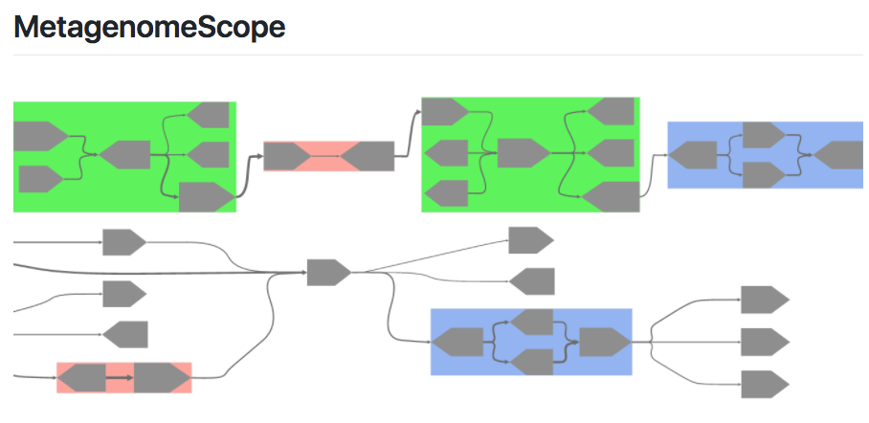
MetaCarvel and MetagenomeScope
Overview of the different types of variants detected by MetaCarvel.
​
We focus on five types of variants:​
A) Triangular bubbles,​
B) Simple four bubbles ​
C) High centrality nodes​
D) Simple Cycles, and ​
E) Multinode cycles
https://github.com/marbl/MetaCarvel
https://github.com/marbl/MetagenomeScope

Slide 13
Biological variants captured by graph motifs
 |  | High-coverage nodes (inter/intragenomic repeats) |  | Simple bubbles (strain variants, gene loss/gain) |  | Cycles
Dataset | Coverage | Tandem repeats | Interspersed repeats | Four-node Bubbles | Three-node Bubbles | Inversions/ Inverted repeats | Plasmids (closed)
HMP2 Stool | 17X | 99442 | 95062 | 4243 | 16967 | 1182573 | 8106
HMP2 Tongue | 28X | 167099 | 120876 | 19872 | 62814 | 2651898 | 15551
HMP2 Plaque | 17X | 1023956 | 62431 | 15106 | 50543 | 1661594 | 21710
HMP2 Cheek | 15X | 175226 | 32615 | 2923 | 9455 | 486016 | 3059

Slide 15
3 bubbles 4 bubbles
Mobilome
Mobilome
RNA processing
RNA processing

Slide 16
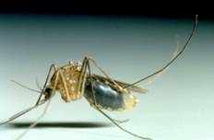
Putting it all together: the search for a pathogen in a mosquito microbiome

Slide 17
Pathogen in Peru
The Orthobunyavirus genus comprises a diverse set of viral species, represented by multiple serogroups, including
Their RNA genome (10 kbp nt) includes three segments (Small [S], Medium [M], and Large [L]).
Speculated to cause febrile like illness

Slide 18
Virus isolation
Mosquitoes were captured at Aotus monkey-baited traps as part of an enzootic dengue study conducted in the vicinity of Iquitos, Peru (Andrews et al. 2014).
Mosquitoes were identified to species, pooled (up to 25 specimens/pool), frozen on dry ice, and kept at -70°C until tested for infectious virus.

Slide 19
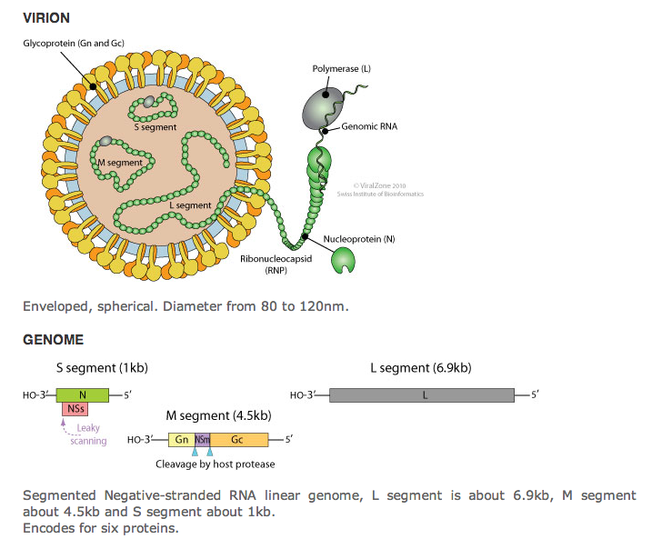
Orthobunyavirus biology
3 segments: Small, Medium, Large
Single-strand, negative sense, RNA genome

Slide 20
Reference DB

Slide 21
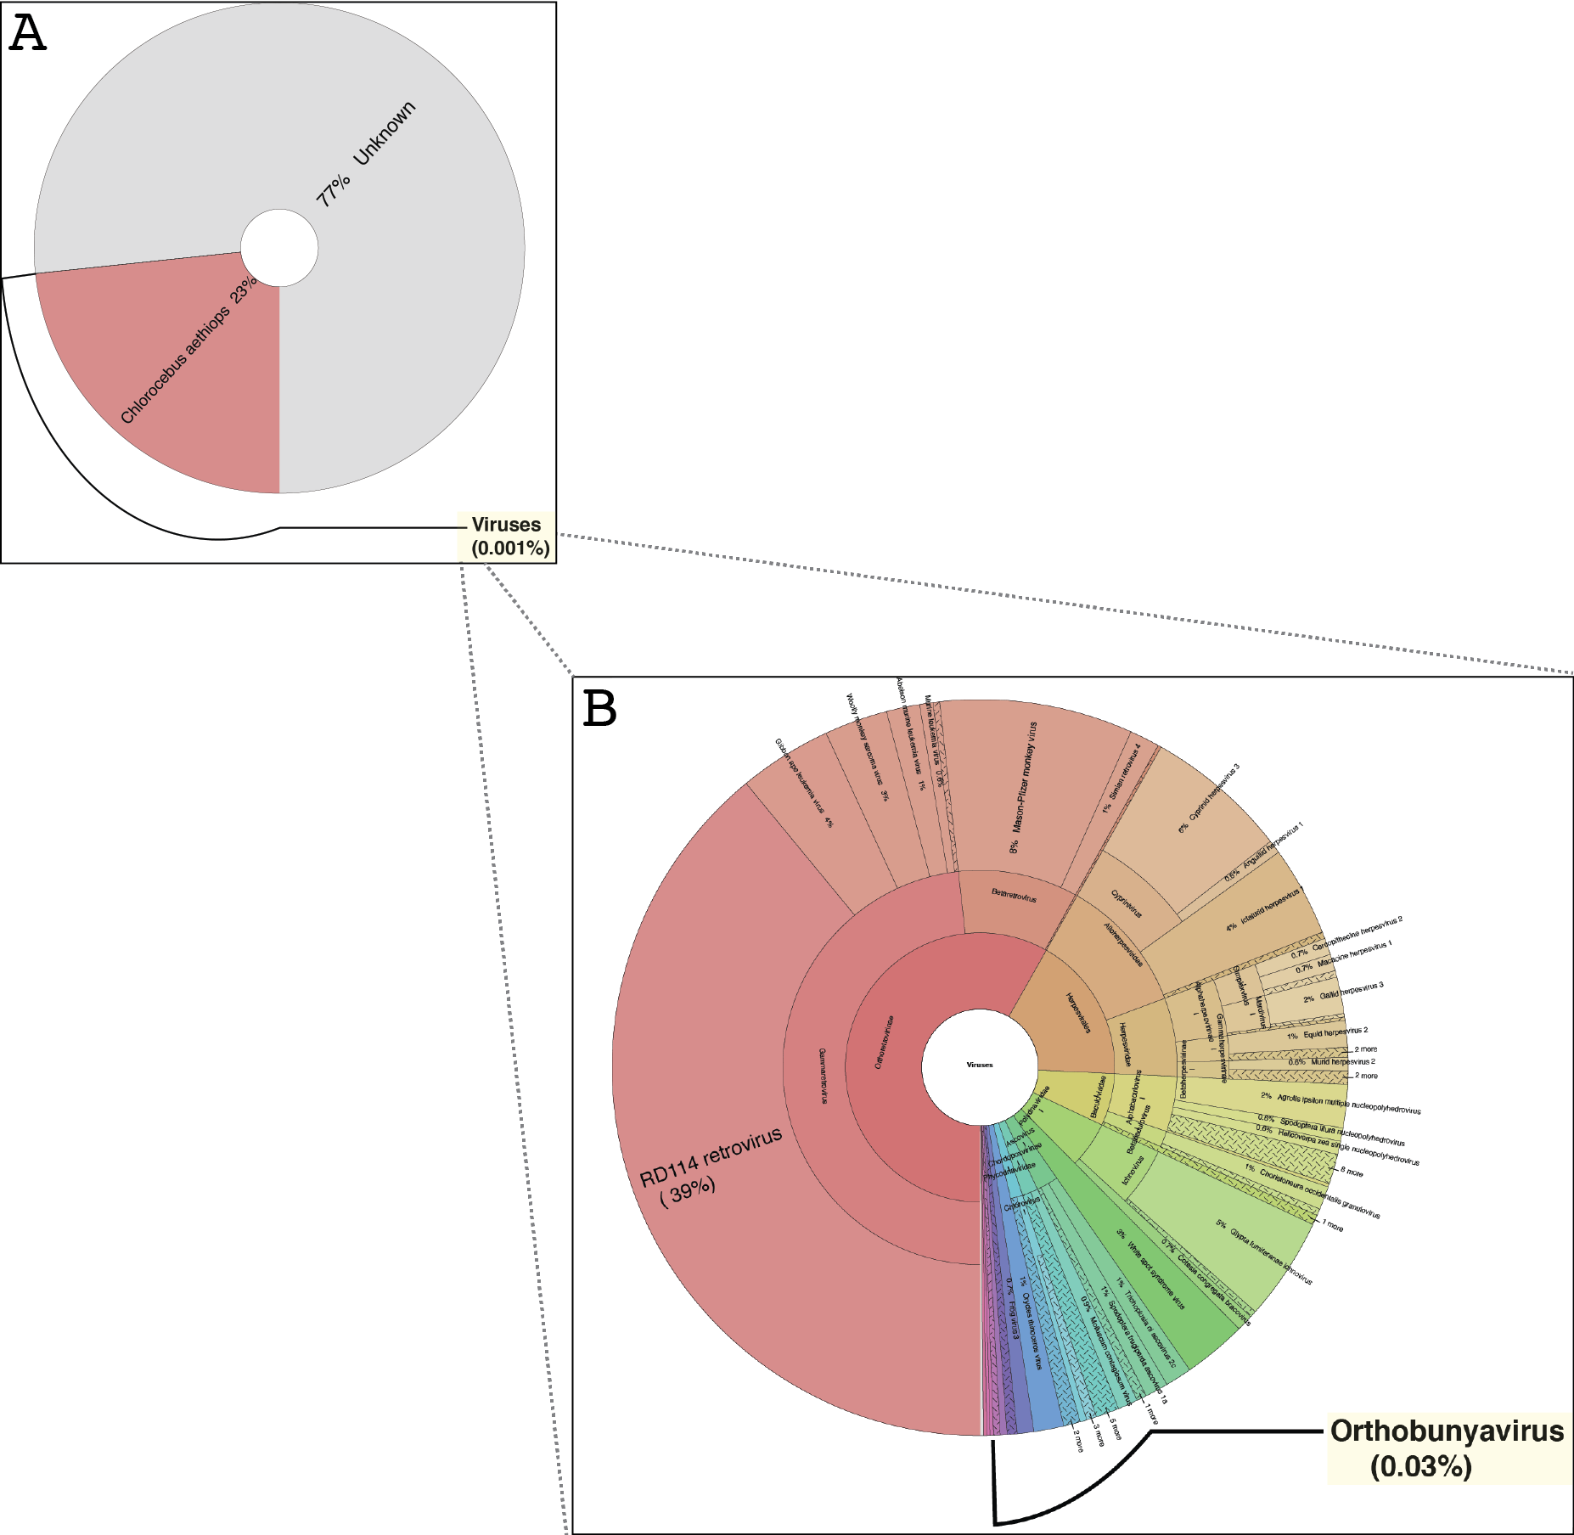

Slide 22
Needle in the haystack: strategies to consider
De novo assembly and post-assembly annotation
Let the assembler figure it out
Reference-guided assembly
No good reference available to target!
Subtractive approach
Remove everything but target (fingers crossed)
Recruitment
Run sensitive alignments (HMM scan) of all reads against related proteins
No risk of missing novel gene content

Slide 23
Full de novo vs recruited asm
Full
IDBA-UD for full de novo assembly of 50 million 100bp HiSeq reads
Resulted in 340,327 contigs, covering all of segment L & M (no segment S), with some notable additions*
Recruited
Blasted reads to Orthobunyavirus DB, word size =7, permissive e-value, 230K total reads (0.5% of sample)
L & M segments assembled into a single contig, S segment not found (800-1000bp)

Slide 24
Coverage plot of Segment L 50 million reads total 120K mapped back to recruited asm

Slide 25
Coverage plot of Segment M 50 million reads total 30K mapped back to recruited asm

Slide 26
Coverage plot of segment L 50 million reads total 500 mapped back to recruited asm

Slide 27
Segment L assembly
Green monkey chr7

Slide 28
About those pesky assembly errors…

Slide 29
Perils
In a metagenome, associating genes to replicons, segments to a virus, is hard (shared gene content between plasmids and chromosomes) and requires assembly/assembly graphs
Single SNPs are important
Annotation is important
Poorly assembled/unavailable host/background sequence is common

Slide 30
Low abundance and RNA virus detection underexplored
Initially only 4 reads out of 400 million using several binning tools were classified in Orthobunyavisus genus.
More sensitive profile HMMs found more (1-2K reads)
Present or not present?
No straightforward way to link viral segments

